Slide 1




Slide 2
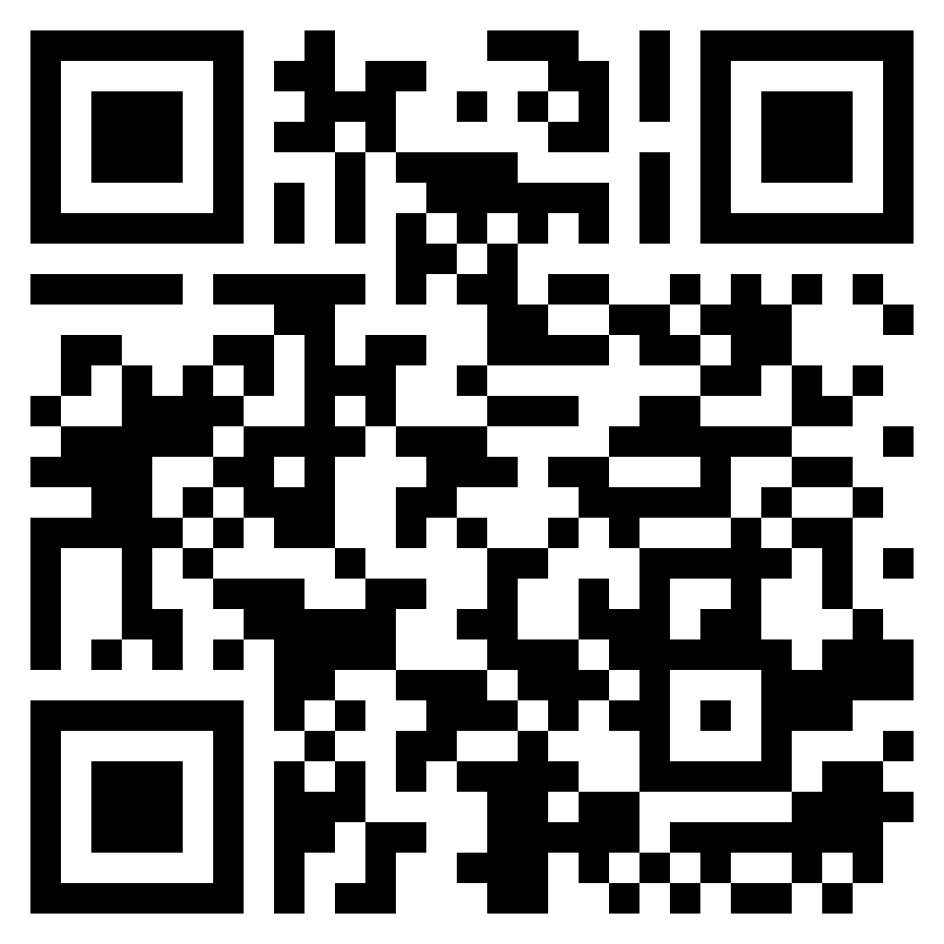
TEST TIME ON TRIGONOMETRY
URL: https://forms.gle/NqaEZ33rpobUVpJ3A
QR CODE:

Slide 3

LOGARITHMS

Slide 4
LOGARITHMS

Slide 5
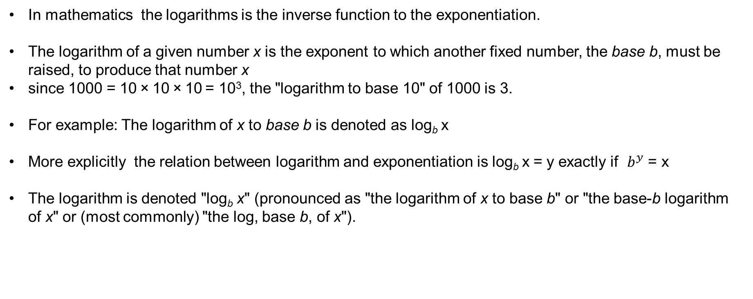
INTRODUCTION

Slide 6
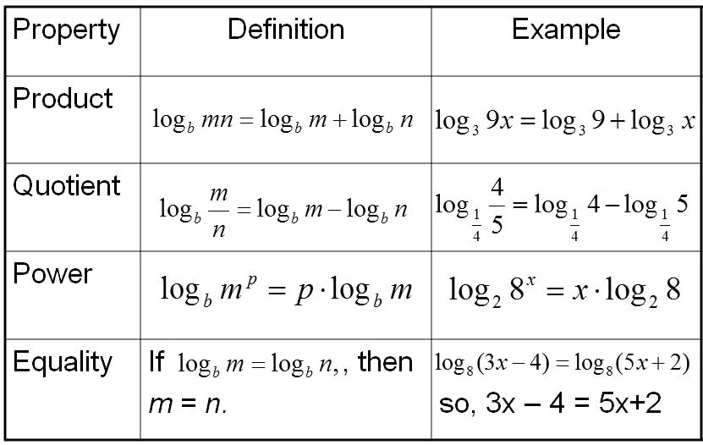
IMPORTANT TERMS

Slide 7
Question: 01
If log 27 = 1.431, then the value of log 9 is ___________.
A. 0.934
B. 0.945
C. 0.954
D. 0.958
Answer: C

Slide 8
Explanation:01
Explanation: 01
Log 27=1.431
log (3³ ) = 1.431
3 log 3 = 1.431
log 3 = 0.477
log 9 = log(3² ) = 2 log 3 = (2 x 0.477) = 0.954.

Slide 9
Question: 02
Question: 02
log₆(216) + [ log(42) - log(6) ] / log(49)
A. 7/2
B. 1/2
C. 4/3
D. 2/3
Answer: A

Slide 10
Explanation:02
Explanation: 02
log₆(216) + [ log(42) - log(6) ] / log(49)
= log₆(6³) + log(42/6) / log(7²)
= 3 + log(7) /2 log(7) = 3 + ½
= 7/2

Slide 11
Question: 03
Question: 03
Find the value of log₂ 2 + log₂ 2² + log₂ 2³ + ........ + log₂ 2^{n}.
A. n(n+1)/2
B. n+1
C. n
D. 2n
Answer: A

Slide 12
Explanation:03
Explanation: 03
log₂ 2 + log₂ 2² + log₂ 2³ + ........ + log₂ 2^{n} = log₂ 2 + 2log₂ 2 + 3log₂ 2 + ........ + nlog₂ 2 = 1+2+3+........+n = n(n+1)/2

Slide 13
Question: 04
Question: 04
If log 2 = 0.301 and log 3 = 0.4771, find the number of digits in 48¹²?
A. 19
B. 20
C. 21
D. 24
Answer: C

Slide 14
Explanation:04
Explanation: 04
We have log 48¹² = 12 × log 48 = 12 × log (2⁴ × 3) = 12 × (4 log 2 + log 3) = 12 × (4 × 0.301 + 0.4771) = 12 × (1.204 + 0.4771) = 12 × 1.6811 = 20.1732 Now the characteristic is 20, so the number of digits = 20 + 1 = 21.

Slide 15
Question: 05
Question: 05
Solve for ‘x:’ the equation is 2log₂x – log₂ (x – 2) = 3
A. 6
B. 4
C. 1
D. 2
Answer: B

Slide 16
Explanation:05
Explanation: 05
We have 2log₂x – log₂ (x – 2) = 3 ⇒ log₂x² – log₂ (x – 2) = 3 ⇒ log₂(x²/x-2) = 3 ⇒ log₂(x²/x-2) = 2³ = 8 ⇒ x² = 8(x-2) ⇒ x² - 8x + 16 = 0 ⇒ (x-4)² = 0 ⇒ x=4 Hence answer is option B

Slide 17
Question: 06
Log₁₀ 3+log₁₀ (4x+1)=log₁₀ (x+1)+1
A. 2/7
B. 7/2
C. 3/7
D. 7/3
Answer: B

Slide 18
Explanation:06
Explanation: 06
log₁₀ 3+log₁₀ (4x+1)=log₁₀ (x+1)+1
Log₁₀ 3+log₁₀ (4x+1)=log₁₀ (x+1)+log₁₀ (x+1)+log₁₀ 10
Log₁₀ (3(4x+1))=log₁₀ (10(x+1))
=3(4x+1)=10(x+1)=12x+3
=10x+10
=2x=7=x=7/2

Slide 19
Question: 07
Question: 07
If log₁₀ 2 = 0.3010, the value of log₁₀ 80 is _________.
A. 1.6020
B. 1.9030
C. 9030
D. None of these
Answer: B

Slide 20
Explanation:07
Explanation: 07
log₁₀ 80 = log₁₀ (8 *10)
= log₁₀ 8 + log₁₀ 10
= log₁₀ (2³ ) + 1
= 3 log₁₀ 2 + 1
= (3 x 0.3010) + 1
= 1.9030.

Slide 21
Question: 08
Question: 08
If log₁₀ 5 + log₁₀ (5x + 1) = log₁₀ (x + 5) + 1, then x is equal to:
A. 1
B. 3
C. 5
D. 10
Answer: B

Slide 22
Explanation:08
Explanation: 08
log₁₀ 5 + log₁₀ (5x + 1) = log₁₀ (x + 5) + 1
log₁₀ 5 + log₁₀ (5x + 1) = log₁₀ (x + 5) + log₁₀ 10
log₁₀ [5 (5x + 1)] = log₁₀ [10(x + 5)]
5(5x + 1) = 10(x + 5)
5x + 1 = 2x + 10
3x = 9
x = 3.

Slide 23
Question: 09
Question: 08
If 2^{2x+4} – 17 × 2^{x+1} = –4, then which of the following is true?
A. x is a positive value
B. x is a negative value
C. x can be either a positive value or a negative value
D. None of these
Answer: C

Slide 24
Explanation:09
Explanation: 09
2^{x+4} – 17 * 2^{x+1} = – 4
2^{x+1} = y
2^{2x+2} = y²
2²(2^{2x+2}) – 17 * 2^{x+1} = –4
4y² – 17y + 4 = 0
4y² – 16y – y + y = 0
4y (y – 4) – 1 (y – 4) = 0
Y = 4
2^{x+1}
x + 1 = 2 or – 2
x = 1 or – 3
the answer is "x can be either a positive value or a negative value".

Slide 25
Question: 10
Question: 10
log₃x + log_{x}3 =17/4. Find X?
A. 3⁴
B. 3^{1/8}
C. 3^{1/4}
D. 3^{1/3}
Answer: C

Slide 26
Explanation: 10
Explanation:10
log₃x + log_{x}3 =17/4
Let y = log₃x
We know that log_{x}3 =1/log 3(x)
Thus the equation can be written as y + 1/y = 174
4y² + 4 = 17y 4y² + 4 - 17y = 0
y = 4 or ¼
log₃x = 4
Then x = 3⁴
If y = 1/4
log₃x = 1/4
x = 3^{1/4}

Slide 27
Question: 11
Question: 11
If log x + log (x + 3) = 1 then the value(s) of x will be, the solution of the equation
x + x + 3 = 1
x + x + 3 = 10
x (x + 3) = 10
x (x + 3) = 1
Answer: C

Slide 28
Explanation:11
Explanation: 11
taking log x= log10x
using the law of logs
Log A+log B=log AB
we have
Log x+log (x+3)=1
Log x(x+3)=1−−(1)
definition of logs
Log ab=c⇒ac=b
(1)→101=x(x+3)
∴x2+3x=10
x2+3x−10=0
factorising and solving
(x+5)(x−2)=0
⇒x=−5, or x=2
When solving with x=2 the equation becomes as option c

Slide 29
Question: 12
Question: 12
Find x if log x = log 1.5 + log 12
A. 18
B. 8
C. 15
D. 12
Answer: A

Slide 30
Explanation: 12
Explanation:12
Given, log x = log 1.5 + log 12
Using the property of logarithms,
i.e., log a + log b = log ab,
we can write log x = log (1.5 × 12)
log x = log 18
Taking antilogarithm on both sides, we get x = 18

Slide 31
Question: 13
Question: 13
log_{a}4 + log_{a}16 + log_{a}64 + log_{a}256 = 10. Then a = __________.
2
4
8
5
Answer: B

Slide 32
log a ⁽⁴⁺¹⁶⁺⁶⁴⁺²⁵⁶⁾ =10 log a 4¹⁰ =10 then a=4
Explanation: 13
Explanation:13
log a ⁽⁴⁺¹⁶⁺⁶⁴⁺²⁵⁶⁾ =10 log a 4¹⁰ =10 then a=4

Slide 33
Question: 14
Question: 14
Log₁₅ 3375 × log ₄ 1024 = __________.
1
18
4
15
Answer: D

Slide 34
Explanation:14
Explanation: 14
log₁₅3375 × log₄1024 = 3 log15 15 × 5 log4 4 = 3 × 5 = 15

Slide 35
Question: 15
Question: 15
If log 3 = 0.4771, find log (0.81) ² × log (27/10)^{2/3} π log 9.
2.689
-0.0552
2.2402
2.702
Answer: D

Slide 36




THANK YOU
+91 78150 95095
codemithra@ethnus.com
www.codemithra.com

